Slide 1

Pairing
BT Curriculum

Slide 2
What is pairing?
This is where everything starts!
You are aiming to become a conditioned reinforcer
Pairing is about making your presence a source of joy for your client, and your presence should be a catalyst for encouraging desired behaviors

Slide 3
Why is pairing so important?
Again, you become a conditioned reinforcer
When a learner finds your attention and/or engagement reinforcing, there will be an increase in cooperation
More cooperation = more fun for you too!

Slide 4
What are some benefits of pairing?
Building rapport
Increased motivation
Increased collaboration
Improved skill acquisition
Reduced problem behavior

Slide 5
How do we pair?
Follow the child’s lead
Use preference assessments
Observation & quality time
Asking caregivers
Identify Reinforcers

Slide 6
How do we pair?
2. Associate yourself with the reinforcer
Delivering the reinforcer
Being around the reinforcer
Jumping into the activity

Slide 7
How do we pair?
3. Gradually introduce demands
This is called Building i_______ c_______
Start by introducing small tasks, then slowly increase frequency & intensity of demands
Be sure tasks are still paired with lots of positivity & encouragement
Notes:
What are some tasks you could start with?

Slide 8
Things to remember:
Pairing is a continuous process
Pairing is not a “one size fits all” strategy
Pairing has it’s own timeline
preferences change!
Pairing should happen each session
Each child & BT might pair differently
Pairing can sometimes happen immediately
Sometimes a client never pairs with a BT

Slide 9
Are there any challenges with pairing?
Pairing should not be a catch-all phrase
Pairing requires balance
Pairing can be overused, creating a shift in instructional control
Pairing can be misused, creating a bad learning history
Notes:
Misuse – can lead to escape/avoidance if you are immediately going back to pairing when things get hard

Slide 10
Here’s a quick recap & resource
Source – How to ABA

Slide 11
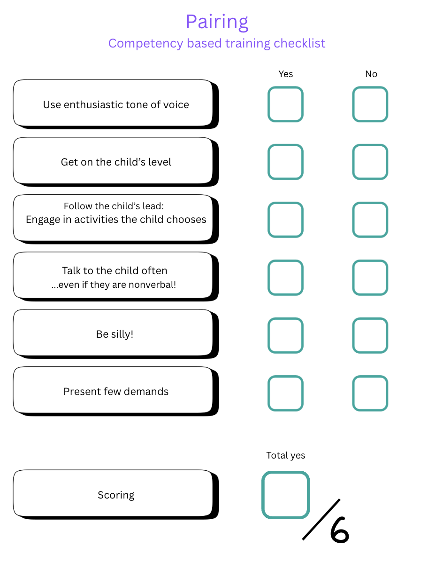
Let’s practice!
Form a group of 2 to role play (5-10 minutes)
Practice with clients (15-20 minutes)
Notes:
Misuse – can lead to escape/avoidance if you are immediately going back to pairing when things get hard

